Slide 1
IN723 BGP Lesson 6
Path influence
AS Path lists
Regex
Community
Prefix lists

Slide 2
Resources
Case Studies
http://www.cisco.com/c/en/us/support/docs/ip/border-gateway-protocol-bgp/26634-bgp-toc.html
Configuration Guide
http://www.cisco.com/c/en/us/td/docs/ios-xml/ios/iproute_bgp/configuration/15-mt/irg-15-mt-book.html
Command Reference
http://www.cisco.com/c/en/us/td/docs/ios-xml/ios/iproute_bgp/command/irg-cr-book.html
Notes:
Microsegmentation = split a larger collision domain into smaller ones in order to reduce collision probability

Slide 3
BGP Path Manipulation
Unlike IGPs, BGP was never designed to choose the quickest path.
BGP was designed to manipulate traffic flow to maximize or minimize bandwidth use.

Slide 4
How to influence inbound vs outbound
Attribute | Applied | Traffic Affected
Weight | Inbound | Outbound
Local-Pref | Inbound | Outbound
AS-Path | Outbound | Inbound
MED | Outbound | Inbound
Note - policies to influence inbound path selection
can be overridden by upstream peers

Slide 5
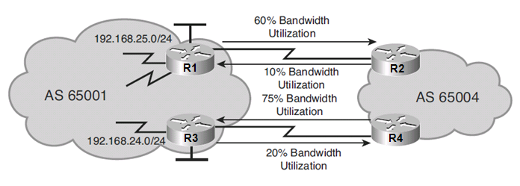
BGP Without Routing Policy Example #1
In this example consider that:
R1 is using 60% of its outbound bandwidth to AS 65004.
R3 is using 20% of its outbound bandwidth to AS 65004.
R2 is using 10% of its outbound bandwidth to AS 65001.
R4 is using 75% of its outbound bandwidth to AS 65001.
Traffic should be diverted using the local preference attribute.
The weight attribute could not be used in this scenario since there are two edge routers.

Slide 6
Which traffic should be re-routed?
To determine which path to manipulate, perform a traffic analysis on Internet-bound traffic by examining the most heavily visited addresses, web pages, or domain names.
Examine network management records or accounting information.
If a heavily accessed traffic pattern is identified, a route map could be used to divert that traffic over the lesser used links

Slide 7
BGP With Routing Policy Example #1
For example, assume that 35% of all traffic from AS 65001 has been going to http://www.cisco.com.
The administrator does a reverse DNS lookup and obtains the Cisco IP address and AS number.
A route map can be used to change the local preference to manipulate packets destined to Cisco’s network over the less used links.
Notes:
The administrator should monitor the outbound loads and adjust the configuration accordingly as traffic patterns change over time.

Slide 8
BGP Routing Policy Example #2
Notice that the inbound load to R3 (75%) is much higher in bandwidth utilization than the inbound load to R1 (10%).
The BGP MED attribute can be used to manipulate how traffic enters autonomous system 65001.
For example, R1 in AS 65001 can announce a lower MED for routes to network 192.168.25.0/24 to AS 65004 than R3 announces.

Slide 9
BGP Routing Policy Example #2
Keep in mind that the MED is considered a recommendation because the receiving autonomous system can override it by manipulating another variable that is considered before the MED is evaluated.
For example, R2 and R4 in AS 65004 could be configured with their own local preference policy which would override the MED recommendation from AS 65001.
BGP Route Selection Process
Prefer highest Weight
Prefer highest LOCAL_PREF
Prefer locally generated routes
Prefer shortest AS_PATH
Prefer lowest ORIGIN (IGP < EGP < incomplete)
Prefer lowest MED
Prefer EBGP over IBGP
Prefer routes through closest IGP neighbor
Prefer routes with lowest BGP router ID
Prefer routes with lowest neighbor IP address

Slide 10
Change the Weight
The weight attribute is used only when one router is multihomed and determines the best path to leave the AS.
Only the local router is influenced.
Higher weight routes are preferred.
There are two ways to alter the route weight:
To change the weight for all updates from a neighbor use the neighbor weight router configuration command.
To change the weight of specific routes / as path, use route maps.
BGP Route Selection Process
Prefer highest Weight
Prefer highest LOCAL_PREF
Prefer locally generated routes
Prefer shortest AS_PATH
Prefer lowest ORIGIN (IGP < EGP < incomplete)
Prefer lowest MED
Prefer EBGP over IBGP
Prefer routes through closest IGP neighbor
Prefer routes with lowest BGP router ID
Prefer routes with lowest neighbor IP address

Slide 11
Changing the Default Weight Example
Assign a default weight to all routes from a peer.
Router(config-router)#
neighbor {ip-address | peer-group-name} weight number
Routes learned through another BGP peer have a default weight of 0 and routes sourced by the local router have a default weight of 32768.
The number is the weight to assign.
Acceptable values are from 0 to 65535.
The route with the highest weight will be chosen as the preferred route when multiple routes are available to a particular network.
Note: The weights assigned with the set weight route-map command override the weights assigned using the neighbor weight command.

Slide 12
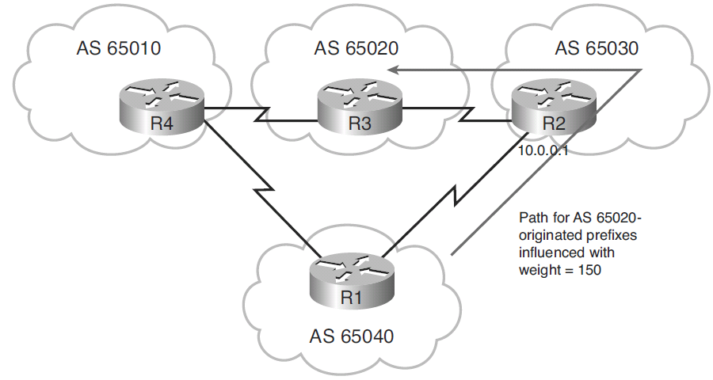
Changing Weight with Route Map Example
In this example consider that:
The routing policy dictates that for any network originated by AS 65020, use the path to AS 65030 as the primary way out of AS 65040.
If R1 needs to access routes connected to R3, then it goes through R2.
This can be achieved by placing a higher weight (150) on all incoming announcements from AS 65030 (10.0.0.1), which carry the information about the network originated in AS 65020.
Notes:
The routing policy dictates the selection of autonomous system 65030 as the primary way out of autonomous system 65040

Slide 13
Changing Weight with Route Map Example
R1(config)# route-map SET-WEIGHT permit 10
R1(config-route-map)# match as-path 10
R1(config-route-map)# set weight 150
R1(config-route-map)#
R1(config-route-map)# route-map SET-WEIGHT permit 20
R1(config-route-map)# set weight 100
R1(config-route-map)# exit
R1(config)# ip as-path access-list 10 permit _65020$
R1(config)#
R1(config)# router bgp 65040
R1(config-router)# neighbor 10.0.0.1 remote-as 65030
R1(config-router)# neighbor 10.0.0.1 route-map SET-WEIGHT in
Notes:
The routing policy dictates the selection of autonomous system 65030 as the primary way out of autonomous system 65040
Sequence 10 specifies that any routes that match AS ACL 10 should be assigned a weight of 150.
AS ACL 10 specifically matches routes that end with the AS 65020.
All other routes go to the next sequence (if any).
Sequence 20 specifies that all other routes should be assigned a weight of 100.
The neighbor command applies the route map to routes that are coming from this neighbor.

Slide 14
Change the Local Preference
The local preference is used only within an AS (between IBGP speakers) to determine the best path to leave the AS.
Higher values are preferred.
The local preference is set to 100 by default.
There are two ways to alter the local preference:
To change the default local-preference for all routes advertised by the router use the bgp default local-preference value router configuration command.
To change the local-preference of specific routes / as path, use route maps.
BGP Route Selection Process
Prefer highest Weight
Prefer highest LOCAL_PREF
Prefer locally generated routes
Prefer shortest AS_PATH
Prefer lowest ORIGIN (IGP < EGP < incomplete)
Prefer lowest MED
Prefer EBGP over IBGP
Prefer routes through closest IGP neighbor
Prefer routes with lowest BGP router ID
Prefer routes with lowest neighbor IP address

Slide 15
Setting Default Local Preference Example
Change the default local preference for outgoing routes.
Router(config-router)#
bgp default local-preference number
The local preference attribute applies a degree of preference to a route during the BGP best path selection process.
The attribute is exchanged only between iBGP peers.
The route with the highest local preference is preferred.
The number is the local preference value from 0 to 4294967295.
Cisco IOS software applies a local preference value of 100.
Note: The local preference assigned with the set local-preference route-map command override the weights assigned using this command.

Slide 16
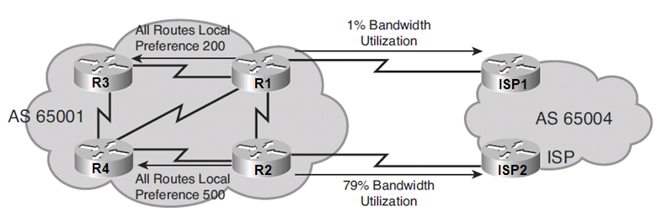
Setting Default Local Preference Example
The BGP routing policy in this example dictates that:
The default local preference for all routes on R1 should be set to 200.
The default local preference for all routes on R2 should be set to 500.

Slide 17
Setting Default Local Preference Example
R1(config)# router bgp 65001
R1(config-router)# bgp default local-preference 200
R1(config-router)#
R2(config)# router bgp 65001
R2(config-router)# bgp default local-preference 500
R2(config-router)#
The resulting configuration makes the IBGP routers in AS 65001 send all Internet bound traffic to R2, but the R1 to ISP1 link is underutilized.
Route maps could be configured to select specific routes to have a higher local preference.

Slide 18
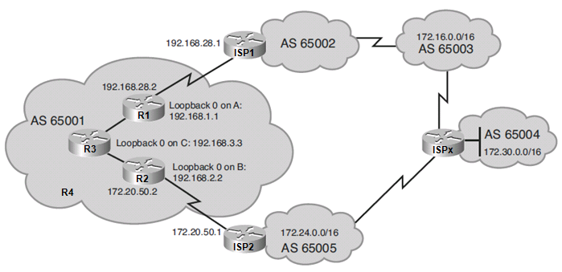
Local Preference and Route Map Example
The BGP routing policy results in the following:
All routes have a weight of 0 and a default local preference of 100.
BGP uses the shortest AS-path to select the best routes as follows:
For network 172.16.0.0, the shortest AS-path is through ISP1.
For network 172.24.0.0, the shortest AS-path is through ISP2.
For network 172.30.0.0, the shortest AS-path is through ISP2.
Notes:
The best path is indicated with a > in the second column of the output.

Slide 19
Local Preference and Route Map Example
R3# show ip bgp
BGP table version is 7, local router ID is 192.168.3.3
Status codes: s suppressed, d damped, h history, * valid, > best, i - internal, r RIB-failure, S Stale
Origin codes: i - IGP, e - EGP, ? - incomplete
Network Next Hop Metric LocPrf Weight Path
* i172.16.0.0 172.20.50.1 100 0 65005 65004 65003 i
*>i 192.168.28.1 100 0 65002 65003 i
*>i172.24.0.0 172.20.50.1 100 0 65005 i
* i 192.168.28.1 100 0 65002 65003 65004 65005 i
*>i172.30.0.0 172.20.50.1 100 0 65005 65004 i
* i 192.168.28.1 100 0 65002 65003 65004i
Notes:
Routes in yellow highlight go from R1 to ISP1.
Routes in blue highlight go from R2 to ISP2.

Slide 20
Local Preference and Route Map Example
A traffic analysis reveals the following traffic patterns:
10% of traffic flows from R1 to ISP1 to network 172.16.0.0.
50% of Internet traffic flow from R2 to ISP2 to networks network 172.24.0.0 and network 172.30.0.0.
The remaining 40 percent is going to other destinations.
A solution is to use route maps to divert traffic to 172.30.0.0 through R1.
Notes:
The best path is indicated with a > in the second column of the output.

Slide 21
Local Preference and Route Map Example
R1(config)# access-list 65 permit 172.30.0.0 0.0.255.255
R1(config)#
R1(config)# route-map LOCAL_PREF permit 10
R1(config-route-map)# match ip address 65
R1(config-route-map)# set local-preference 400
R1(config-route-map)#
R1(config-route-map)# route-map LOCAL_PREF permit 20
R1(config-route-map)# exit
R1(config)#
Notes:
Sequence 10 specifies that any routes that match ACL 65 should be assigned a local preference of 400.
ACL 65 specifically permits 172.30.0.0/16 routes.
All other routes go to the next sequence (if any).
Sequence 20 contains no match statement therefore all other traffic permitted.
In this case, the local preference for the 172.16.0.0 and 172.24.0.0 networks remains set at the default of 100.
Traffic to 172.16.0.0 still flows from R1 to ISP1.
Traffic to 172.24.0.0 still flows from R2 to ISP2.

Slide 22
Local Preference and Route Map Example
R1(config)# router bgp 65001
R1(config-router)# neighbor 192.168.2.2 remote-as 65001
R1(config-router)# neighbor 192.168.2.2 update-source loopback0
R1(config-router)# neighbor 192.168.3.3 remote-as 65001
R1(config-router)# neighbor 192.168.3.3 update-source loopback0
R1(config-router)# neighbor 192.168.28.1 remote-as 65002
R1(config-router)# neighbor 192.168.28.1 route-map LOCAL_PREF in
R1(config-router)# exit
R1(config)#
Notes:
The neighbor command applies the LOCAL_PREF route map to routes that are coming from ISP1.
Now when ISP1 advertises the 172.30.0.0/16 route to R1, the local preference will be set to 400 making it the preferred link for the other IBGP routers in the AS.

Slide 23
Local Preference and Route Map Example
R3# show ip bgp
BGP table version is 7, local router ID is 192.168.3.3
Status codes: s suppressed, d damped, h history, * valid, > best, i - internal, r RIB-failure, S Stale
Origin codes: i - IGP, e - EGP, ? - incomplete
Network Next Hop Metric LocPrf Weight Path
* i172.16.0.0 172.20.50.1 100 0 65005 65004 65003 i
*>i 192.168.28.1 100 0 65002 65003 i
*>i172.24.0.0 172.20.50.1 100 0 65005 i
* i 192.168.28.1 100 0 65002 65003 65004 65005 i
* i172.30.0.0 172.20.50.1 100 0 65005 65004 i
*>i 192.168.28.1 400 0 65002 65003 65004i
Notes:
Routes in yellow highlight go from R1 to ISP1.
Routes in blue highlight go from R2 to ISP2.

Slide 24
Modifying the AS Path
By default, if no BGP path selection tools are configured to influence traffic flow (i.e. weight, local-preference), BGP uses the shortest AS path, regardless of available bandwidth.
To influence the path selection based on the AS_PATH, configure AS-path prepending.
The AS path is extended with multiple copies of the AS number of the sender making it appear longer.
BGP Route Selection Process
Prefer highest Weight
Prefer highest LOCAL_PREF
Prefer locally generated routes
Prefer shortest AS_PATH
Prefer lowest ORIGIN (IGP < EGP < incomplete)
Prefer lowest MED
Prefer EBGP over IBGP
Prefer routes through closest IGP neighbor
Prefer routes with lowest BGP router ID
Prefer routes with lowest neighbor IP address

Slide 25
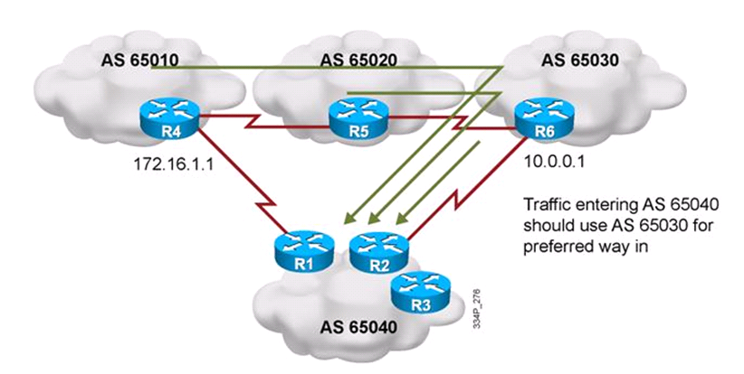
Modifying the AS Path Example
The BGP routing policy in this example dictates that:
Traffic entering AS 65040 should be through R6 in AS 65030 and not R4 in AS 65010.
One way to do this is make R1 advertise the AS 65040 networks with a less desirable AS path by configuring AS-path prepending.

Slide 26
Modifying the AS Path Example
R1(config)# route-map SET-AS-PATH permit 10
R1(config-route-map)# set as-path prepend 65040 65040 65040
R1(config-route-map)# exit
R1(config)# router bgp 65040
R1(config-router)# neighbor 172.16.1.1 remote-as 65010
R1(config-router)# neighbor 172.16.1.1 route-map SET-AS-PATH out
R1(config-router)# exit
R1(config)#
Notes:
Sequence 10 specifies to add the three AS numbers to the AS_PATH.
The neighbor command applies the SET-AS-PATH route map to routes advertised to R4.
R4 will receive the routes from R1 but will choose to forward its traffic through R6.

Slide 27
Setting the MED
MED is used to decide how to enter an AS when multiple paths exist.
When comparing MED values for the same destination network in the BGP path-selection process, the lowest MED value is preferred.
Default is 0.
However, because MED is evaluated late in the BGP path-selection process, it usually has no influence.
There are two ways to alter the MED:
To change the MED for all routes use the default-metric router configuration command.
To change the MED of specific routes / as path, use route maps.
BGP Route Selection Process
Prefer highest Weight
Prefer highest LOCAL_PREF
Prefer locally generated routes
Prefer shortest AS_PATH
Prefer lowest ORIGIN (IGP < EGP < incomplete)
Prefer lowest MED
Prefer EBGP over IBGP
Prefer routes through closest IGP neighbor
Prefer routes with lowest BGP router ID
Prefer routes with lowest neighbor IP address

Slide 28
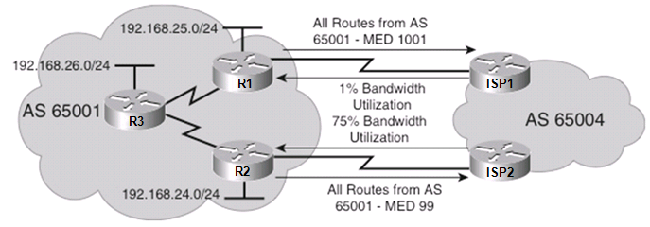
Setting the Default MED Example
The BGP routing policy in this example dictates that:
The default MED of R1 should be changed to 1001.
The default MED of R2 should be changed to 99.

Slide 29
Setting the Default MED Example
R1(config)# router bgp 65001
R1(config-router)# default metric 1001
R1(config-router)#
R2(config)# router bgp 65001
R2(config-router)# default metric 99
R2(config-router)#
The results are that the inbound bandwidth utilization on:
R1 to ISP1 link has decreased to almost nothing except for BGP routing updates.
R2 to ISP2 link has increased due to all returning packets from AS 65004.
A better solution is to have route maps configured that will make some networks have a lower MED through R1 and other networks to have a lower MED through R2.

Slide 30
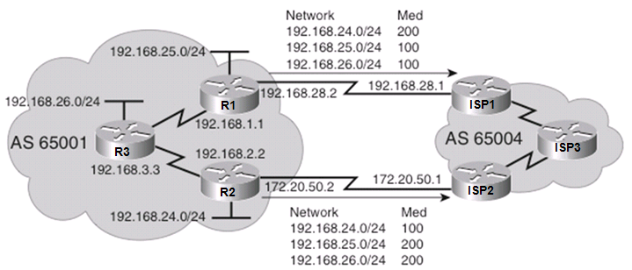
Setting the MED with Route Maps Example
R1(config)# access-list 66 permit 192.168.25.0 0.0.0.255
R1(config)# access-list 66 permit 192.168.26.0 0.0.0.255
R1(config)#
R1(config)# route-map MED-65004 permit 10
R1(config-route-map)# match ip address 66
R1(config-route-map)# set metric 100
R1(config-route-map)#
R1(config-route-map)# route-map MED-65004 permit 100
R1(config-route-map)# set metric 200
R1(config-route-map)# exit
R1(config)#
Notes:
Sequence 10 specifies that any routes that match ACL 66 should be assigned a MED of 100.
ACL 66 specifically permits the 192.168.25.0/24 and 192.168.26.0/24 routes.
All other routes go to the next sequence (if any).
Sequence 100 sets the MED for all other routes to 200.

Slide 31
Setting the MED with Route Maps Example
R1(config)# router bgp 65001
R1(config-router)# neighbor 192.168.2.2 remote-as 65001
R1(config-router)# neighbor 192.168.2.2 update-source loopback0
R1(config-router)# neighbor 192.168.3.3 remote-as 65001
R1(config-router)# neighbor 192.168.3.3 update-source loopback0
R1(config-router)# neighbor 192.168.28.1 remote-as 65004
R1(config-router)# neighbor 192.168.28.1 route-map MED-65004 out
R1(config-router)#exit
Notes:
The neighbor route-map command applies the MED-65004 to outgoing routes.

Slide 32
Setting the MED with Route Maps Example
R2(config)# access-list 66 permit 192.168.24.0 0.0.0.255
R2(config)#
R2(config)# route-map MED-65004 permit 10
R2(config-route-map)# match ip address 66
R2(config-route-map)# set metric 100
R2(config-route-map)#
R2(config-route-map)# route-map MED-65004 permit 100
R2(config-route-map)# set metric 200
R2(config-route-map)# exit
R2(config)#
Notes:
Sequence 10 specifies that any routes that match ACL 66 should be assigned a MED of 100.
ACL 66 specifically permits the 192.168.24.0/24 route.
All other routes go to the next sequence (if any).
Sequence 100 sets the MED for all other routes to 200.

Slide 33
Setting the MED with Route Maps Example
R2(config)# router bgp 65001
R2(config-router)# neighbor 192.168.1.1 remote-as 65001
R2(config-router)# neighbor 192.168.1.1 update-source loopback0
R2(config-router)# neighbor 192.168.3.3 remote-as 65001
R2(config-router)# neighbor 192.168.3.3 update-source loopback0
R2(config-router)# neighbor 172.20.50.1 remote-as 65004
R2(config-router)# neighbor 172.20.50.1 route-map MED-65004 out
R2(config-router)# exit
R2(config)#
Notes:
The neighbor route-map command applies the MED-65004 to outgoing routes.

Slide 34
Setting the MED with Route Maps Example
ISP3# show ip bgp
BGP table version is 7, local router ID is 192.168.1.1
Status codes: s suppressed, d damped, h history, * valid, > best, i - internal, r RIB-failure, S Stale
Origin codes: i - IGP, e - EGP, ? - incomplete
Network Next Hop Metric LocPrf Weight Path
*>i192.168.24.0 172.20.50.2 100 100 0 65001 i
* i 192.168.28.2 200 100 0 65001 i
* i192.168.25.0 172.20.50.2 200 100 0 65001 i
*>i 192.168.28.2 100 100 0 65001 i
* i192.168.26.0 172.20.50.2 200 100 0 65001 i
*>i 192.168.28.2 100 100 0 65001 i
Notes:
ISP3 will return traffic to the 192.168.24.0/24 network via the ISP2 to R2 link due to the lower MED.
ISP3 will return traffic to the 192.168.25.0 /24 and 192.168.26.0 /24 networks via the ISP1 to R1 link due to the lower MED.

Slide 35
Verifying BGP: show ip bgp
Display the BGP topology database (the BGP table).
The status codes are shown in the first column of each line of output.
* means that the next-hop address (in the fifth column) is valid.
r means a RIB failure and the route was not installed in the RIB.
R1# show ip bgp
BGP table version is 14, local router ID is 172.31.11.1
Status codes: s suppressed, d damped, h history, * valid, > best, i - internal, r RIB-failure, S Stale
Origin codes: i - IGP, e - EGP, ? - incomplete
Network Next Hop Metric LocPrf Weight Path
*> 10.1.0.0/24 0.0.0.0 0 32768 i
* i 10.1.0.2 0 100 0 i
*> 10.1.1.0/24 0.0.0.0 0 32768 i
*>i10.1.2.0/24 10.1.0.2 0 100 0 i
*> 10.97.97.0/24 172.31.1.3 0 64998 64997 i
* 172.31.11.4 0 64999 64997 i
* i 172.31.11.4 0 100 0 64999 64997 i
*> 10.254.0.0/24 172.31.1.3 0 0 64998 i
* 172.31.11.4 0 64999 64998 i
* i 172.31.1.3 0 100 0 64998 i
r> 172.31.1.0/24 172.31.1.3 0 0 64998 i
r 172.31.11.4 0 64999 64998 i
r i 172.31.1.3 0 100 0 64998 i
*> 172.31.2.0/24 172.31.1.3 0 0 64998 i
A > in the second column indicates the best path for a route selected by BGP.
This route is offered to the IP routing table.
The third column is either blank or has an “i” in it.
- If it has an i, an IBGP neighbor advertised this route to this router.
- If it is blank, BGP learned that route from an external peer.
This section lists three BGP path attributes: metric (MED), local preference, and weight.
The Path section lists the AS path. The last AS # is the originating AS.
If blank the route is from the current autonomous system.
The last column displays the ORIGIN attribute).
- i means the original router probably used a network command to introduce this network into BGP.
- ? means the route was probably redistributed from an IGP into the BGP process.
Notes:
Other first column options:
An s indicates that the specified routes are suppressed (usually because routes have been summarized and only the summarized route is being sent).
A d, for dampening, indicates that the route is being dampened (penalized) for going up and down too often. Although the route might be up right now, it is not advertised until the penalty has expired.
An h, for history, indicates that the route is unavailable and is probably down. Historic information about the route exists, but a best route does not exist.
An r, for RIB failure, indicates that the route was not installed in the RIB. The reason that the route is not installed can be displayed using the show ip bgp rib-failure command.
An S, for stale, indicates that the route is stale. (This is used in a nonstop forwarding aware router.)

Slide 36
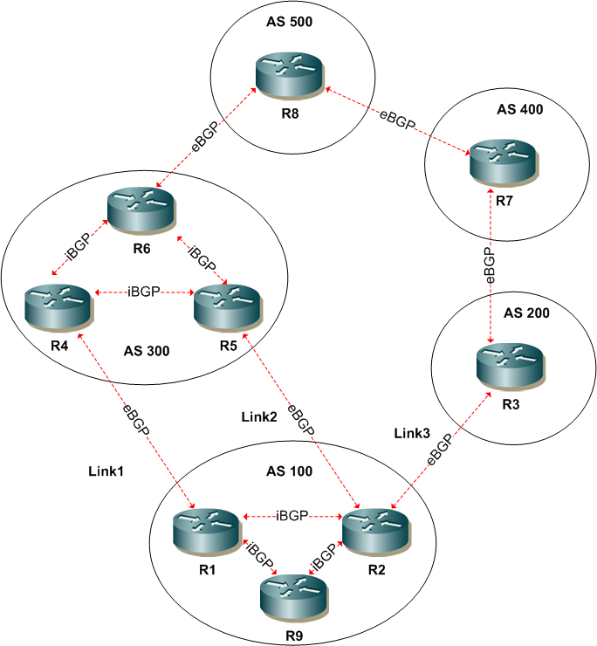
EXERCISE

Slide 37
Scenario 1
For a prefix originated in AS500 which link would R2 prefer outbound ?
Why would it not prefer the link to R1
A: Link 2 – shortest AS path, eBGP preferred over iBGP

Slide 38
Scenario 2
Apply a policy in AS100 so that link 1 is favoured outbound via R1.
A: set a high local preference for routes learned from neighbour R4

Slide 39
Scenario 3
Apply a policy in AS100 so that AS500 uses the path via AS400 to AS100
A: use AS path prepending for prefixes advertised to peers over link1 & link2.
Prepend twice or more.

Slide 40
Scenario 4
Apply a policy in AS100 so that AS300 uses link2 to reach AS100 but does not influence AS500.
A: set lower MED on prefixes to R5 & higher MED on prefixes to R4.

Slide 41
AS Path List & Regular Expression
Can be complex (regular expressions)
Allows route filtering / selection based on the AS Path of a prefix
An AS path list is defined which comprises a regular expression that is compared with a prefix’s AS_PATH
Can apply AS_PATH list regular expression using a filter list via BGP neighbor statement
Or via route-map

Slide 42
AS Path List
Example - To accept only routes that originated in AS 300
router bgp 100
neighbor <ip> filter-list 1 in
ip as-path access-list 1 permit _300$

Slide 43
AS Path List cont …
Some regular expression values
^ = start of the list
$ = end of the list
_ = space, comma, brace, parenthesis, beginning of string, end of string
. = any single character
* = 0 or more sequences of the pattern
+ = 1 or more sequences of the pattern
[] = range of single characters e.g [0-9]
? = 0 or 1 of proceeding characters
/ = escape = remove special meaning of a character
() = grouping

Slide 44
Regular Expression Examples
Regular Expression | Resulting Expression
a* | Expression indicates any occurrence of the letter "a", which includes none
a+ | indicates that at least one occurrence of the letter "a" must be present
ab?a | Expression matches "aa" or "aba".
_100_ | Expression means via AS100.
_100$ | Expression indicates an origin of AS100.
^100 .* | Expression indicates transmission from AS100
^$ | Expression indicates origination from this AS

Slide 45
AS Path List cont …
To advertise routes originated in local AS using route-map
router bgp 100
neighbor <ip> route-map LOCAL-AS out
route-map LOCAL-AS permit 10
match as-path 1
ip as-path access-list 1 permit ^$
Note local AS is prepended after the filtering
AS-Path lists - Originating AS is rightmost
AS-PATH attribute – Originating AS is rightmost
Implicit deny all

Slide 46
AS Path List cont …
What does this do ?
router bgp 100
neighbor <ip> filter-list 1 in
ip as-path access-list 1 deny _200_
ip as-path access-list 1 deny ^30[0-5]_
ip as-path access-list 1 permit .*
Notes:
_200_ = any instance of AS200
^30[0-5]_ = directly connected AS is AS300-AS305
.* = match any

Slide 47
AS Path List cont …
A more complex example
This as-path list allows routes from directly connected AS 501 & its directly connected customers
ip as-path access-list 1 permit ^501(_[0-9]+)?$
Notes:
? = 0 or more. + = 1 or more

Slide 48
AS Path List cont …
Other Examples
^[0-9]+$ = any directly connected AS
^[0-9]+(_[0-9])+)?$ = any directly connected AS and their customers
^100(_[0-9]+)?$ = AS100 and its customers
^\(.*\)$ = originated in confederation, \ = escape char
^100_ = learned from – directly connected
_100$ = originated in
Notes:
Enter ? in CLI = Ctrl+v then ?

Slide 49
How to know it works ?
Test with
show ip bgp regexp <expression>
will compare the expression vs the current BGP table and return the matches

Slide 50
Communities
A community is a group of prefixes that share some common property and can be configured with the BGP community attribute
The community value itself does not alter the BGP best path selection process
Like tagging they allow a router to take an action based on the community value. e.g filter, preference, redistribute
Community attributes can be applied to inbound or outbound prefixes
Is “optional transitive” which means it can be passed between BGP speakers but must be explicitly configured to do so
Route maps are used to set the community attribute

Slide 51
Communities cont …
Predefined communities
no-export—Do not advertise this route to EBGP peers
no-advertise—Do not advertise this route to any peer
internet—Advertise this route to the Internet community; all routers in the network belong to it. Can be used to match any community
local-as— Used in confederations – can be advertised to other sub ASes but not external to AS that forms the confederation

Slide 52
Communities cont …
User defined in 2 ways
Decimal format (old way) – number between 1 – 4294967200
AA:NN format (new way) – AA is 16 bit AS number & NN is arbitrary 16 bit number
To configure new format requires global command
ip bgp-community new-format

Slide 53
Communities cont …
Example setting community
ip bgp-community new-format
router bgp 100
neighbor 131.23.1.3 remote-as 200
neighbor 131.23.1.3 send-community
neighbor 131.23.1.3 route-map SET-COMMUNITY out
ip access-list standard LOCAL-SUBNETS
permit 100.1.0.0 0.0.255.255
permit 110.1.0.0 0.0.255.255
route-map SET-COMMUNITY permit 10
match ip address LOCAL-SUBNETS
set community 100:250
Note require “send community” command for community attribute to be propagated

Slide 54
Communities cont …
standard & extended (default = standard)
neighbor 131.23.1.3 send-community [standard | extended | both]
extended communities used to support MPLS VPNs

Slide 55
Communities cont …
Verify
Rack1R6#show ip bgp 28.119.16.0
BGP routing table entry for 28.119.16.0/24, version 8
Paths: (1 available, best #1, table Default-IP-Routing-Table)
Advertised to update-groups:
1
54
54.1.2.254 from 54.1.2.254 (212.18.3.1)
Origin IGP, localpref 200, valid, external, best
Community: 100:250

Slide 56
Scenario 5
Apply a policy in AS100 so that AS300 does not advertise any AS100 originated routes external to AS300
A: R1 & R2 to AS300 set community no-export for local prefixes.

Slide 57
Scenario 6
What AS_PATH regex could R3 use to match prefixes originating in AS500?
What AS_PATH regex could R2 use to match prefixes from directly connected AS200?
What AS_PATH regex could R8 use to match prefixes learned via AS100 or AS200?
Notes:
1 = _500$
2 = ^400_
3 = _[1-2]00_

Slide 58
Scenario 7
Define a policy for AS100 so that AS300 will use the R5 to R2 link for specific prefixes advertised by AS100 to AS300. Do not use AS-PATH prepending or MED.
Notes:
R1 & R2 set community tag value
R4 & R5 match community tag value and set Local pref higher for R5 to R2.
Example of agreed policy between customer & provider. Provider may prefer this as Local-pref is higher up the path selection list.

Slide 59
Configuration For Setting Attributes
router bgp 100
neighbor <ip> route-map SET-BGP-ATTRIBUTES in
neighbor <ip> route-map SET-BGP-ATTRIBUTES out
neighbor <ip> weight <Weight vlaue>
route-map SET-BGP-ATTRIBUTES permit 10
match ip address <ACL>
match ip address prefix-list <prefix-list>
match community <community-list>
match as-path <as-path list>
set local-preference <preference value>
set metric <MED value>
set weight <Weight value>
set origin <egp | igp | incomplete>
set as-path prepend <AS> <AS> …

Slide 60
Route Filtering
neighbor <ip> route-map <route-map name> in
neighbor <ip> route-map <route-map name> out
neighbor <ip> prefix-list <prefix-list> in
neighbor <ip> prefix-list <prefix-list> out
neighbor <ip> distribute-list <ACL> in
neighbor <ip> distribute-list <ACL> out
A Route-map can be used to match
Access list
Prefix list
Community list
As-path list

Slide 61
Configure a Prefix List
Define a prefix list.
Router(config)#
ip prefix-list {list-name | list-number} [seq seq-value] {deny | permit} network/length [ge ge-value] [le le-value]
Parameter | Description
list-name | The name of the prefix list that will be created (it is case sensitive).
list-number | The number of the prefix list that will be created.
seq seq-value | A 32-bit sequence number of the prefix-list statement. Default sequence numbers are in increments of 5 (5, 10, 15, and so on).
deny | permit | The action taken when a match is found.
network / length | The prefix to be matched and the length of the prefix. The network is a 32-bit address; the length is a decimal number.
ge ge-value | (Optional) The range of the prefix length to be matched. The range is assumed to be from ge-value to 32 if only the ge attribute is specified.
le le-value | (Optional) The range of the prefix length to be matched. The range is assumed to be from length to le-value if only the le attribute is specified.

Slide 62
Apply a Prefix List
Apply a prefix list to routes from or to a neighbor.
Router(config-router)#
neighbor {ip-address | peer-group-name} prefix-list prefix-list-name {in | out}
Parameter | Description
ip-address | IP address of the BGP neighbor.
peer-group-name | Name of a BGP peer group.
prefix-list-name | Name of a prefix list.
in | Prefix list is applied to incoming advertisements.
out | Prefix list is applied to outgoing advertisements.

Slide 63
BGP Filtering Using Prefix Lists Example
AS 65001
AS 65002
.1
172.16.1.0/24
.2
R1
R2
172.16.10.0
R1(config)# ip prefix-list ANY-8to24-NET permit 0.0.0.0/0 ge 8 le 24
R1(config)# router bgp 65001
R1(config-router)# neighbor 172.16.1.2 remote-as 65002
R1(config-router)# neighbor 172.16.1.2 prefix-list ANY-8to24-NET in
R1(config-router)# end
R1#
R1# show ip prefix-list detail ANY-8to24-NET
ip prefix-list ANY-8to24-NET:
Description: test-list
count: 1, range entries: 1, sequences: 10 - 10, refcount: 3
seq 10 permit 0.0.0.0/0 ge 8 le 24 (hit count: 0, refcount: 1)
Notes:
The prefix list ANY-8to24-NET is applied to the incoming advertisements from the BGP neighbor 172.16.1.2.
It permits routes from any network with a mask length from 8 to 24 bits.
The output from the show ip prefix-list detail command on router R2.
Router R2 has a prefix list called ANY-8to24-NET that has only one entry (sequence number 10).
The hit count of 0 means that no routes have matched this entry.
Use the clear ip prefix-list prefix-list-name [network/length] command to reset the hit count shown on prefix list entries.
The length specified by ge should naturally be longer than the length of the initial prefix as it is impossible to match anything larger than the initial prefix.

Slide 64
Route Filtering Example
deny default route inbound and allow everything else
ip prefix-list DENY-DEFAULT seq 5 deny 0.0.0.0/0
ip prefix-list DENY-DEFAULT seq 10 permit 0.0.0.0/0 le 32
router bgp 100
neighbor 131.23.1.3 prefix-list DENY-DEFAULT in

Slide 65
Route Filtering Example Cont …
Another way – Route-map & prefix-list
ip prefix-list MATCH-DEFAULT seq 5 permit 0.0.0.0/0
ip route-map DENY-DEFAULT deny 10
match ip address prefix-list MATCH-DEFAULT
ip route-map DENY-DEFAULT permit 20
router bgp 100
neighbor 131.23.1.3 route-map DENY-DEFAULT in

Slide 66
Route Filtering Example Cont …
A third way - Route-map & ACL
ip access-list standard MATCH-DEFAULT
deny 0.0.0.0 0.0.0.0
permit any
route-map DENY-DEFAULT permit 10
match ip address MATCH-DEFAULT
router bgp 100
neighbor 131.23.1.3 route-map DENY-DEFAULT in

Slide 67
Order of Preference of BGP Attributes
For inbound updates the order of preference is:
route-map
filter-list (AS-PATH filtering)
prefix-list, distribute-list
For outbound updates the order of preference is:
prefix-list, distribute-list
filter-list
route-map
Prefix-list and distribute-list are mutually exclusive, and only one command (neighbor prefix-list or neighbor distribute-list) can be applied to each inbound or outbound direction for a particular neighbour
Recommend using a single method e.g route-map
Notes:
Applied in the above order. Advise to test as conflicting reports depending on IOS.

